Slide 1



END POINT SECURITY
RAHUL SECURITY ANALYST

Slide 2

What is Endpoint security..?
Endpoint: An endpoint is any device that connects to a network — examples include: laptops, desktops, mobile phones, servers, or IoT devices. These act as entry and exit points for communication and data exchange between users and the organization’s network..
Security: Security refers to the protection of systems, networks, and data from unauthorized access etc. The goal is to maintain confidentiality, integrity, and availability (CIA) of information Endpoint security: Endpoint Security combines both — it focuses on protecting endpoints (devices) using various security control .It ensures that every device connected to the organization’s network is monitored, protected, and compliant with security policies.

Slide 3

Evolution of Endpoint security
AV
NGAV
ESS
EDR
XDR
Antivirus software protects leveraging a DB of know signatures
Antivirus software protects leveraging a DB of know signatures
Antivirus software protects leveraging a DB of know signatures
Antivirus software protects leveraging a DB of know signatures
Extended detection and response (Cross data analytics insights)
Antivirus
Next-Gen Antivirus
Endpoint security suite
Endpoint detection and response
Antivirus software protects leveraging a DB of know signatures
Antivirus software protects leveraging of know signatures
Next-Gen Antivirus provides exploit protection-based detection
Endpoint protection deliver bundled antivirus with device control, policy enforcement, and centralized management
NGEP + EDR collects rich telemetry, builds timelines, and helps analysts investigate and respond.
Which pulls in email, cloud, network, and endpoint signals into a single correlated view so defenders can see the full story

Slide 4

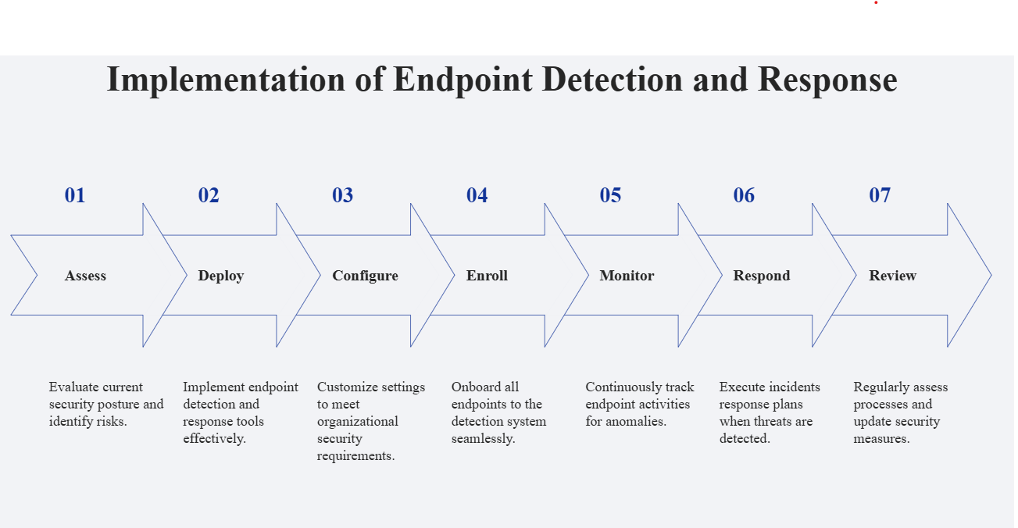

Slide 5
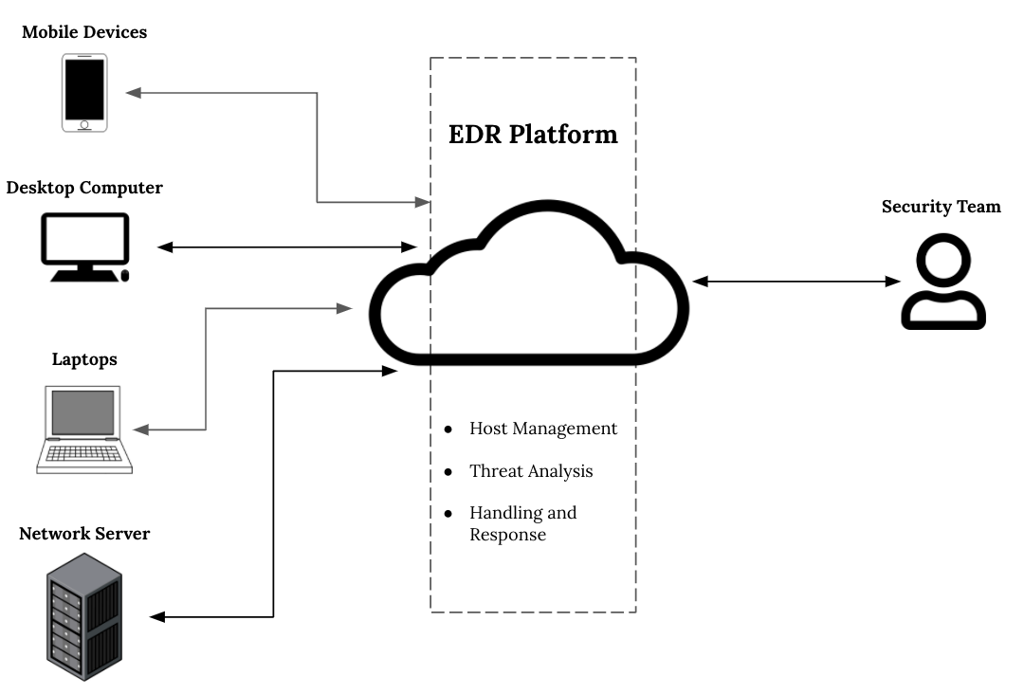

Endpoint Security Architecture
Sensor/agents installed on endpoints
Real-Time Telemetry to Cloud
Cloud engine uses AI + threat intel to detect malware
Block, quarantine, isolate machine, and rollback ransomware damage remotely.

Slide 6
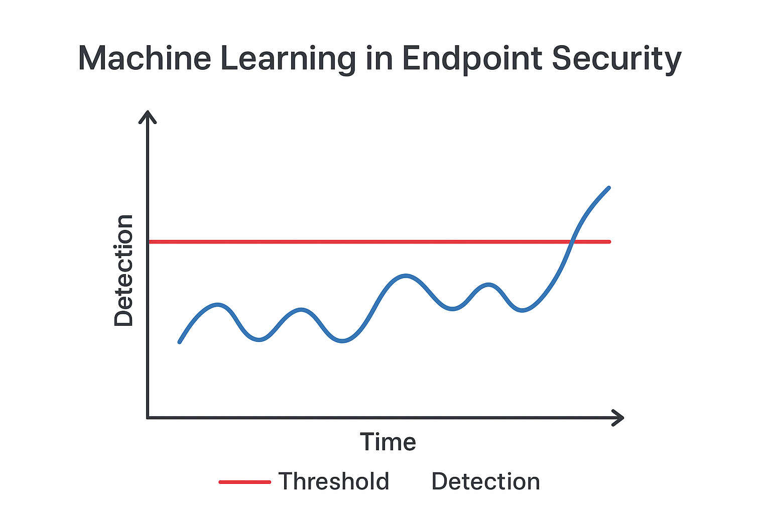
ML-Based Anomaly Detection in Endpoint Security
How MACHINE LEARNING Works in EDR
Machine learning models continuously evaluate endpoint behaviours.
When the anomaly score surpasses a defined threshold, it signals a potential threat.
This helps detect unknown or evolving malware activity without relying solely on known signatures.

Slide 7
Key Aspects Endpoint Security
Provides real-time insight into all endpoints to detect and stop adversary activities instantly.
Collects and enriches vast telemetry data to identify attacks through advanced analytics.
Uses behavioural analysis and IOAs to detect suspicious activities before compromise.
Its like the brain — it takes that data, connects the dots, and helps us understand who’s attacking us, how, and why..
EDR that enables a fast and accurate response to incidents can stop an attack before it becomes a breach
Having a cloud-based endpoint detection and response solution is the only way to ensure zero impact on endpoints
Endpoint visibility:
Threat database:
Behavioural protection:
Insight and intelligence:
Fast response:
Cloud-based solution: :

Slide 8
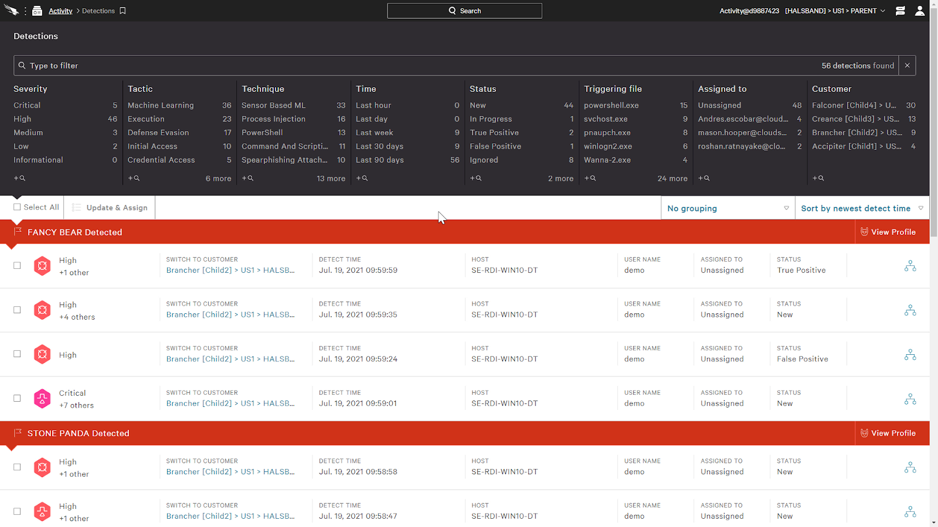
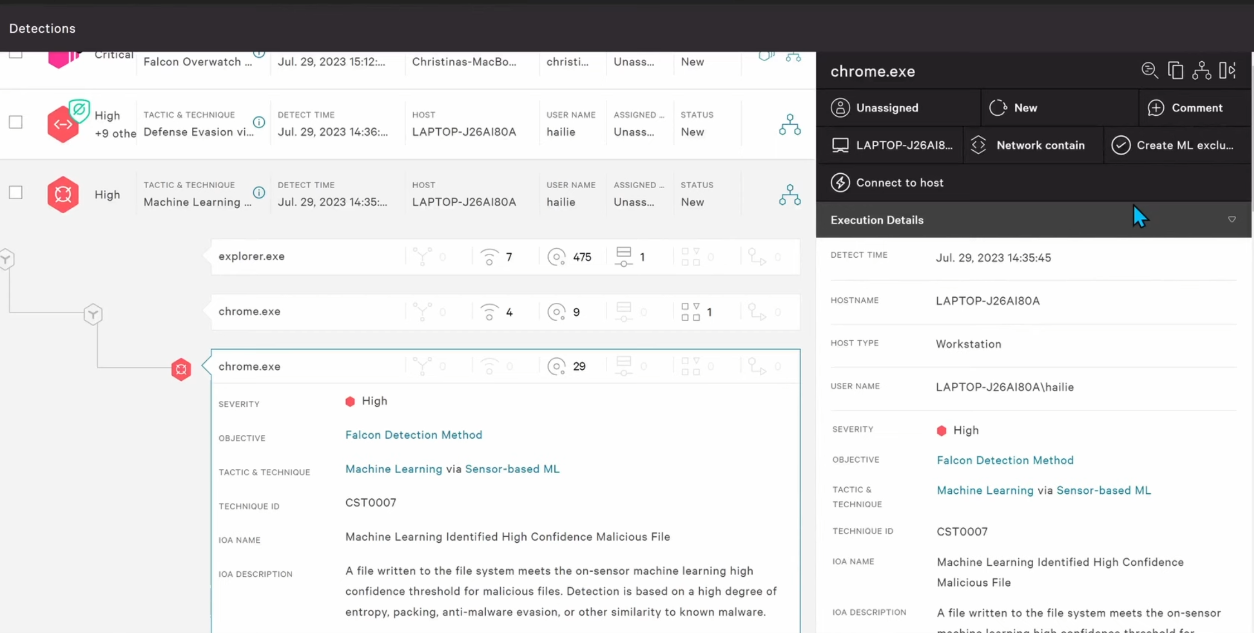
Detection in Endpoint Security

Slide 9
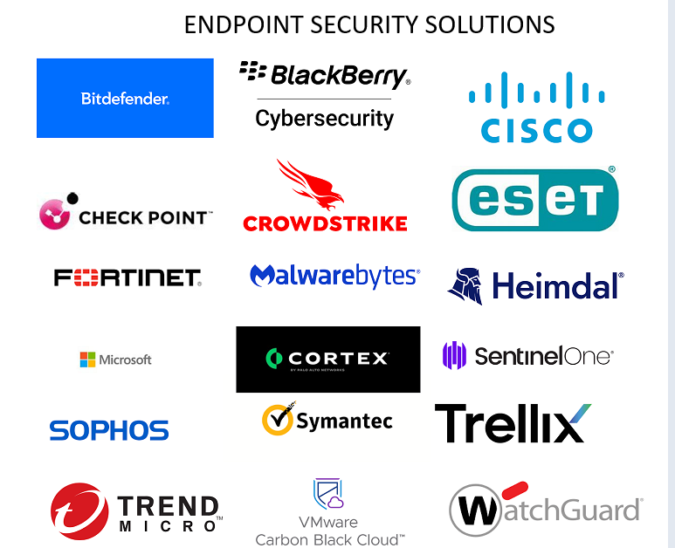
Crowdstrike - Sensor
Sentinelone - Agent
Microsoft defender- Defender agent
Sophos – Endpoint agent
Trellix Mccafe - Agent
Trendmicro - Agent
CORTEX - Agent
Symantec – Client

Slide 10
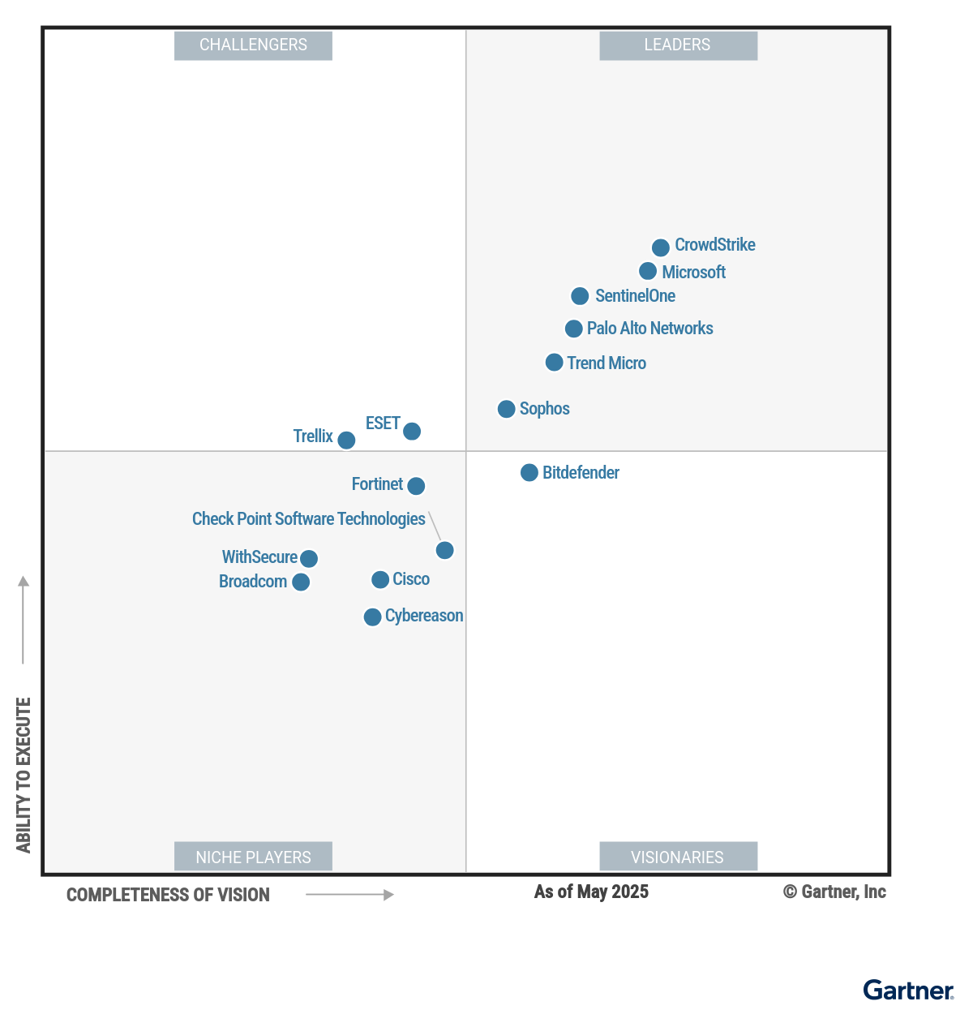
Magic Quadrant for Endpoint Protection Platforms
Magic Quadrant – What Gartner Evaluates ?
Gartner publishes the Magic Quadrant for Endpoint Protection Platforms (EPP) — evaluating vendors by two axes:
Ability to Execute
Completeness of Vision
Vendors are classified into four quadrants: Leaders, Challengers, Visionaries, and Niche Players.
The Magic Quadrant serves as a go-to reference for organizations selecting endpoint security solutions.
Link : Gartner

Slide 11
Thank You

